Slide 1

Macroeconomics II
Lecture 10
The economics of Climate Change and growth

Slide 2
Theoretical Lecture 10 Climate change and economic effects
The Stern Report;
The Paris Agreement on climate change;
Recent discussions.
Portugal: the case of forest fires and systemic impacts.
Readings:
Louçã & Mortágua (2021), Chapter 14
Stern Report (summary available for students in Aquila, report available online)
NASA site on climate change: https://climate.nasa.gov/
Stern, N. (2016), “Economics: Current climate models are grossly misleading”, Nature, 24 February 2016, available in:http://www.nature.com/news/economics-current-climate-models-are-grossly-misleading-1.19416

Slide 3
Theoretical Lecture 10 Climate change and economic effects
The Stern Report;
The Paris Agreement on climate change;
Recent discussions.
Portugal: the case of forest fires and systemic impacts.
Readings:
Stern Report (summary available for students in Aquila, report available online)
NASA site on climate change: https://climate.nasa.gov/
Stern, N. (2016), “Economics: Current climate models are grossly misleading”, Nature, 24 February 2016, available in:http://www.nature.com/news/economics-current-climate-models-are-grossly-misleading-1.19416
Core Project, ch 1 (Aquila)

Slide 4
Long run causes and effects
= difficult systemic solutions

Slide 5
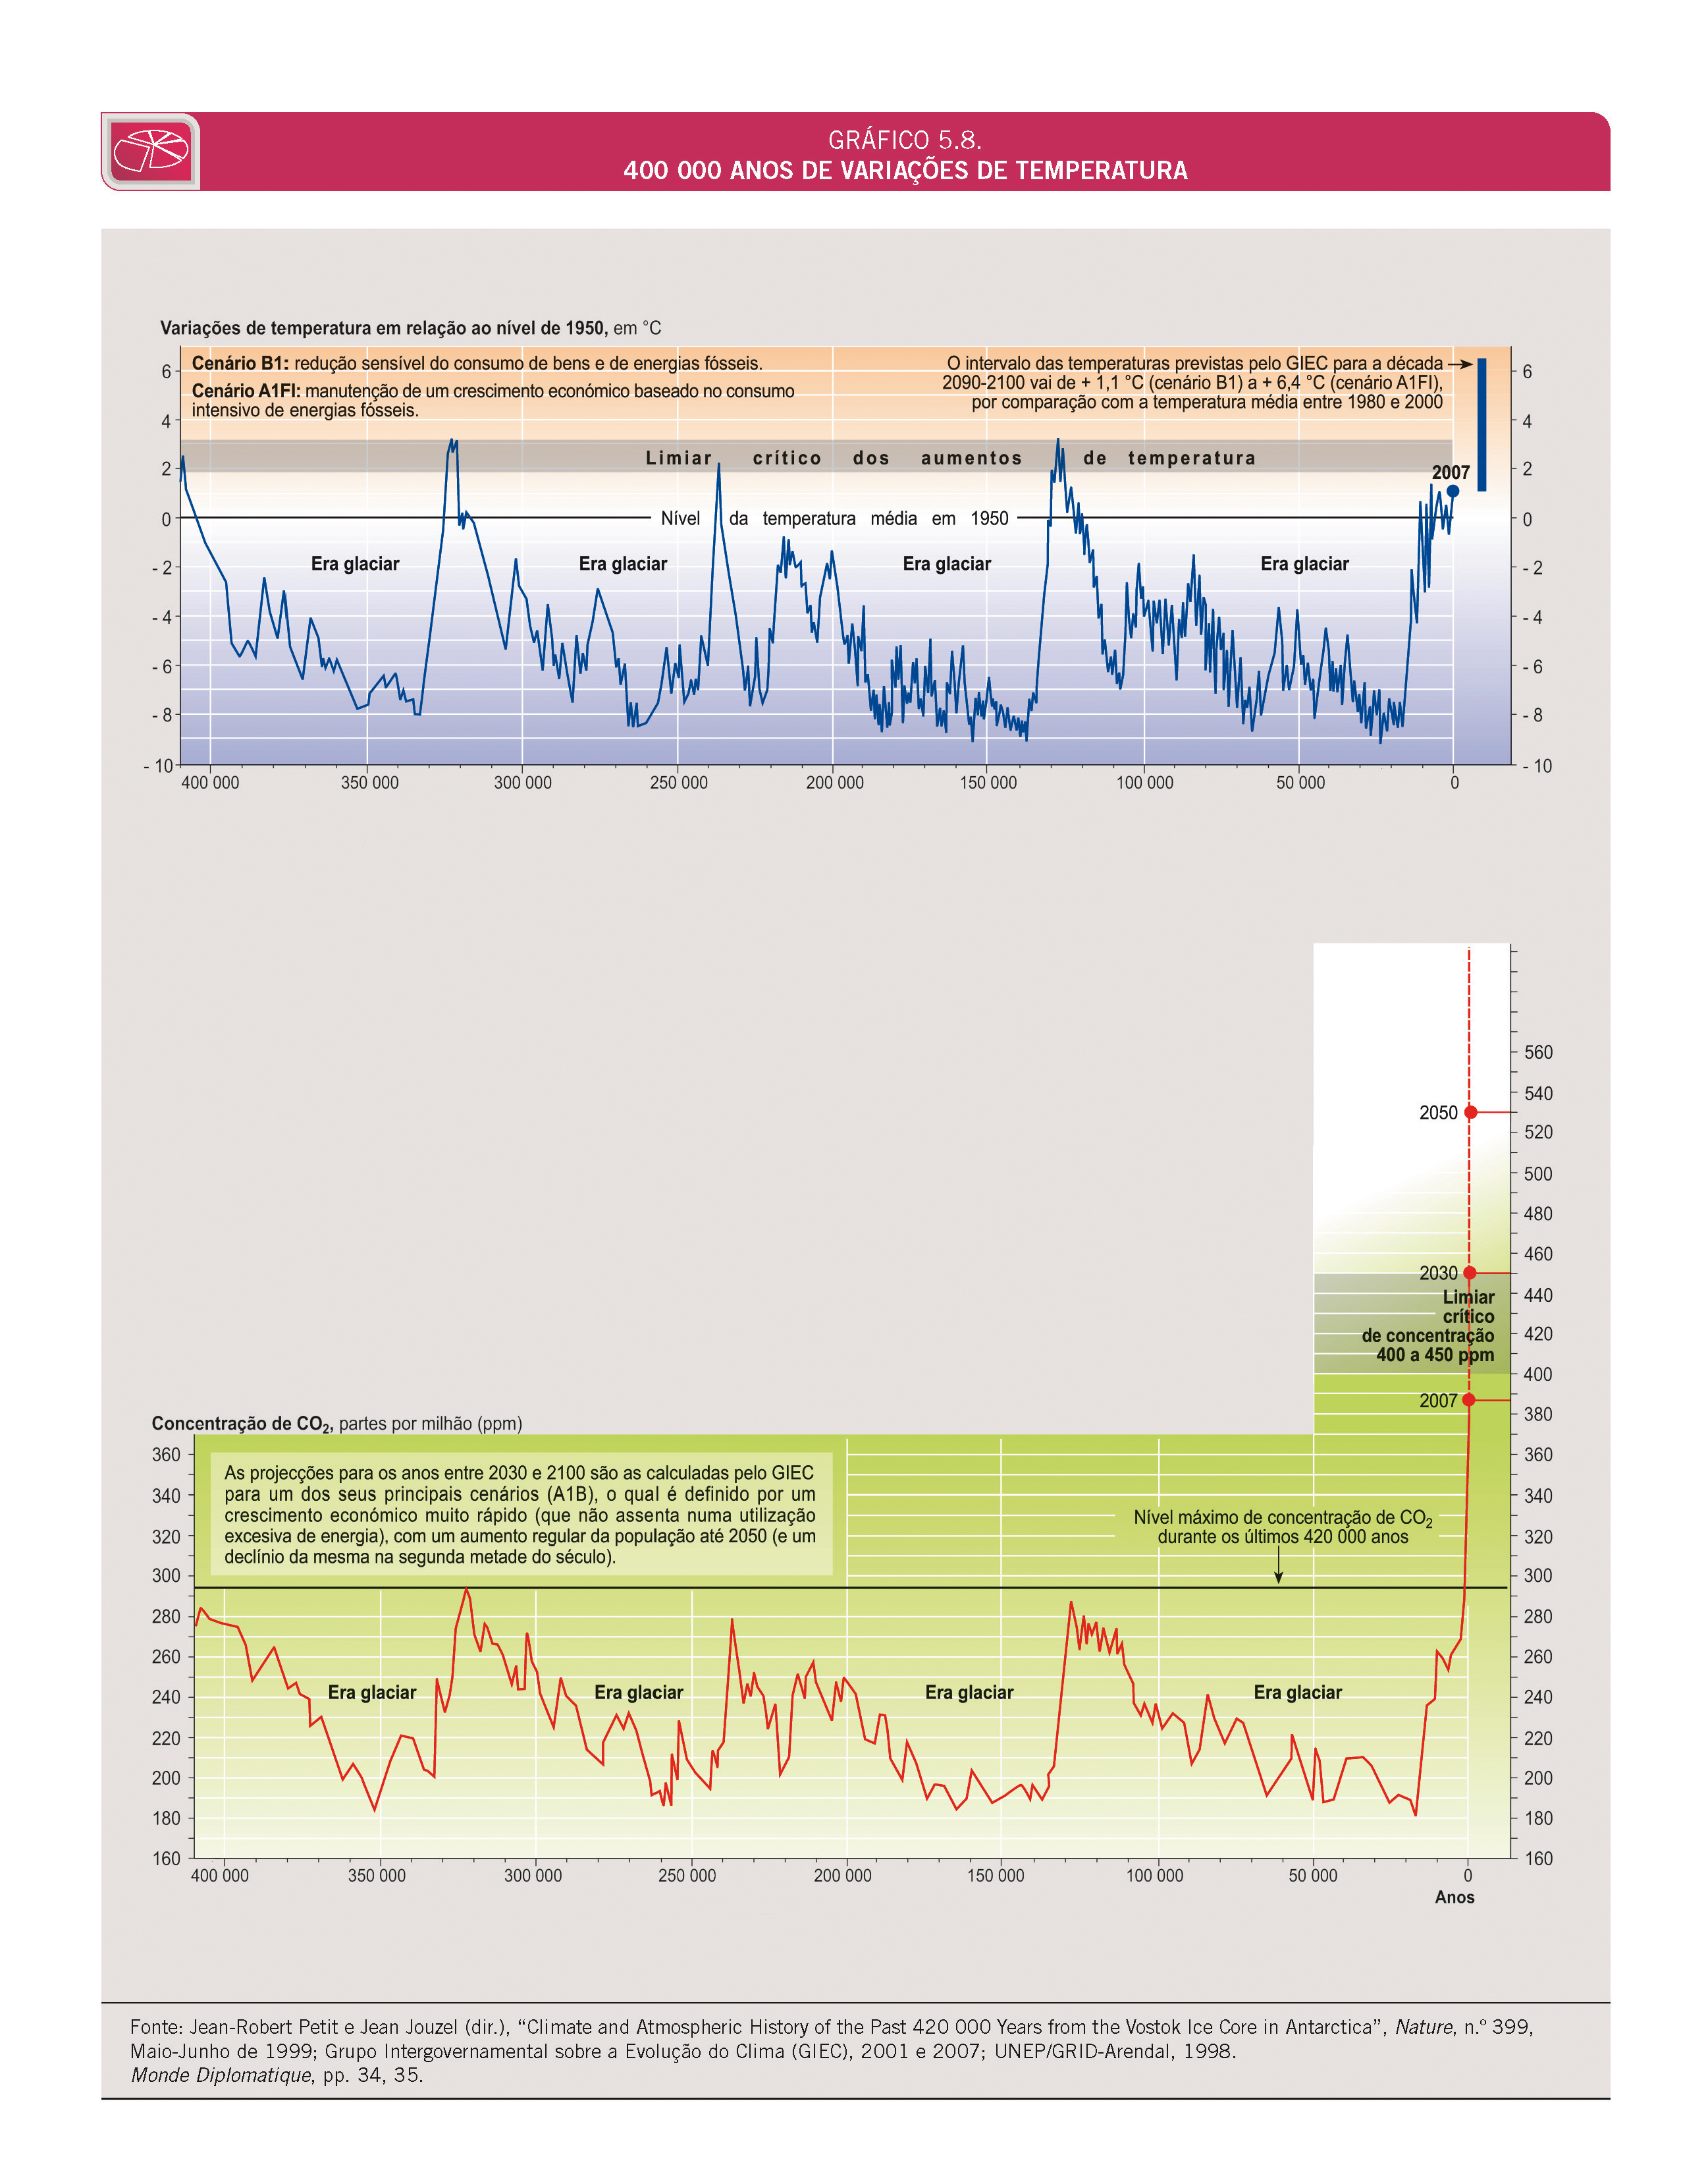
Global warming
Economias_Graficos_Page_038.jpg

Slide 6
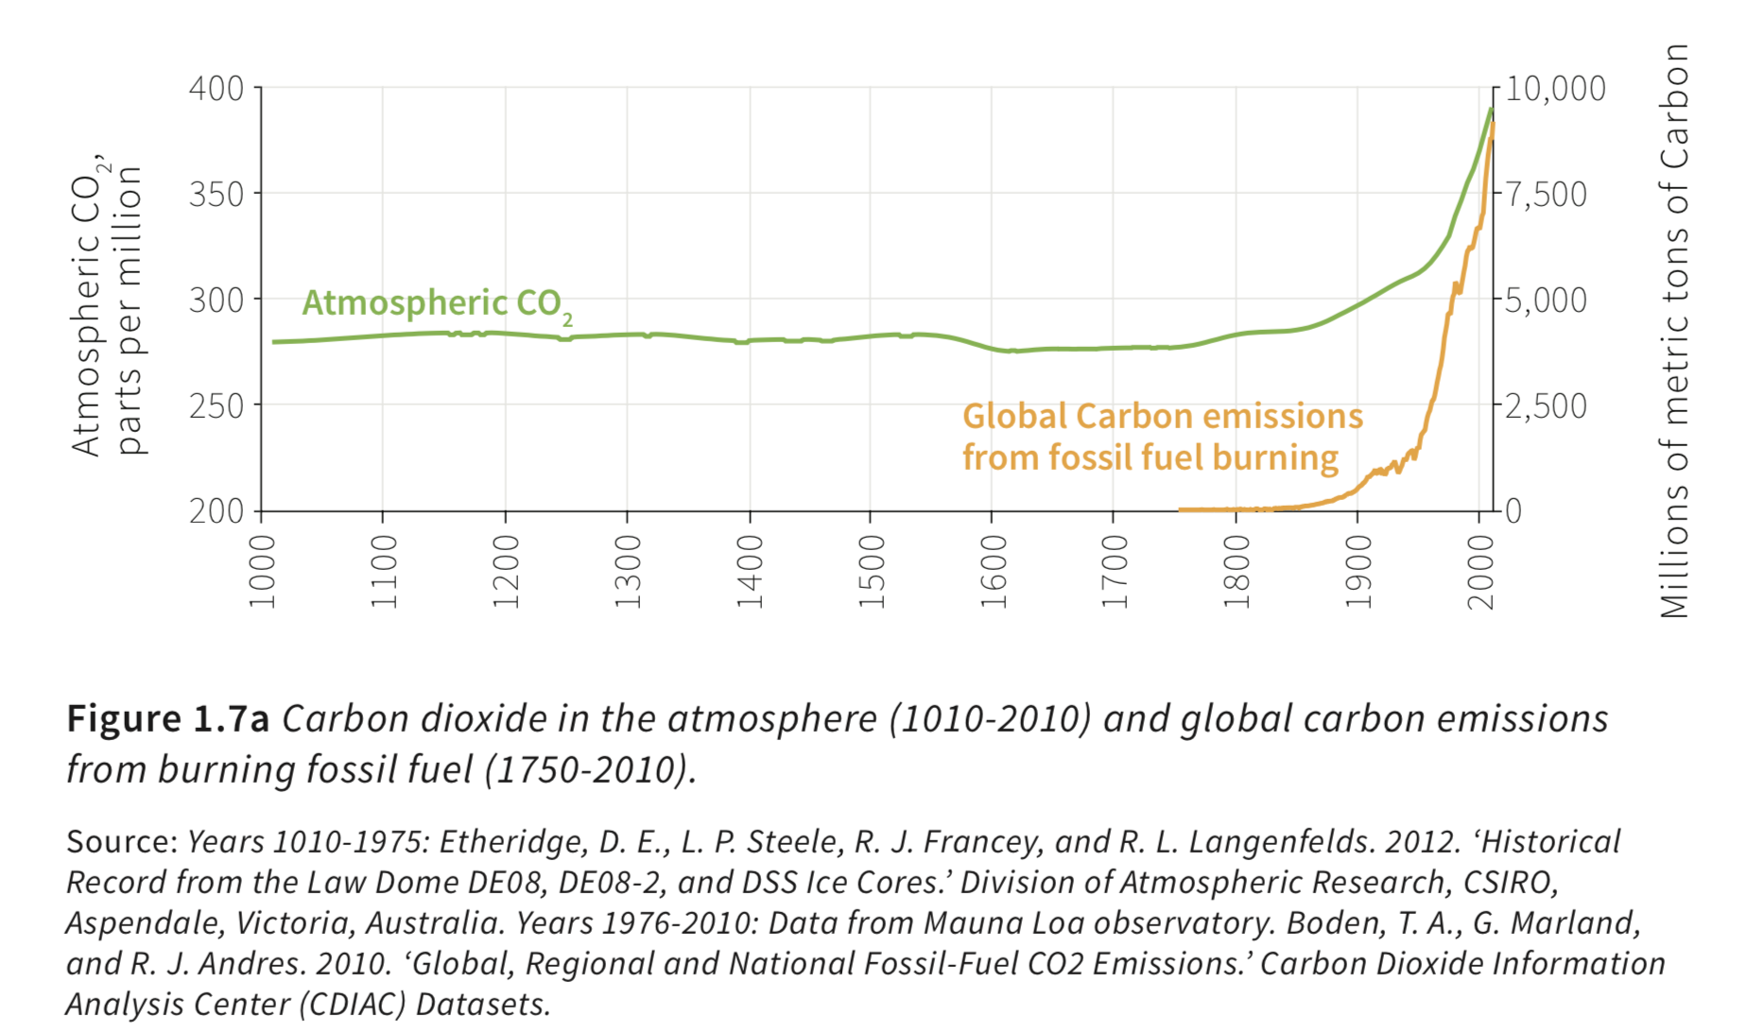
A long history and a recent disaster

Slide 7
Just the North for a thousand years

Slide 8
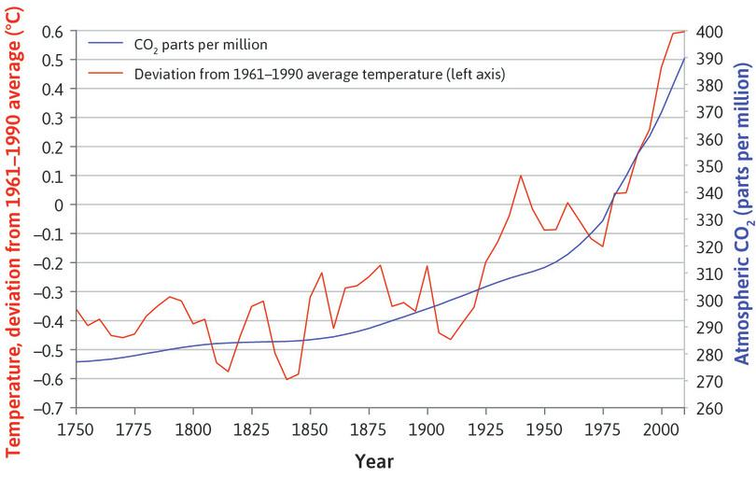
After the industrial revolution:
Concentration of CO₂ in the atmosphere

Slide 9
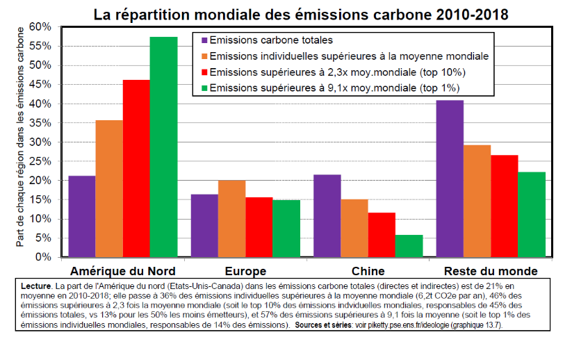
Is there and excess production of CO₂? Who is endangering the planet?

Slide 10
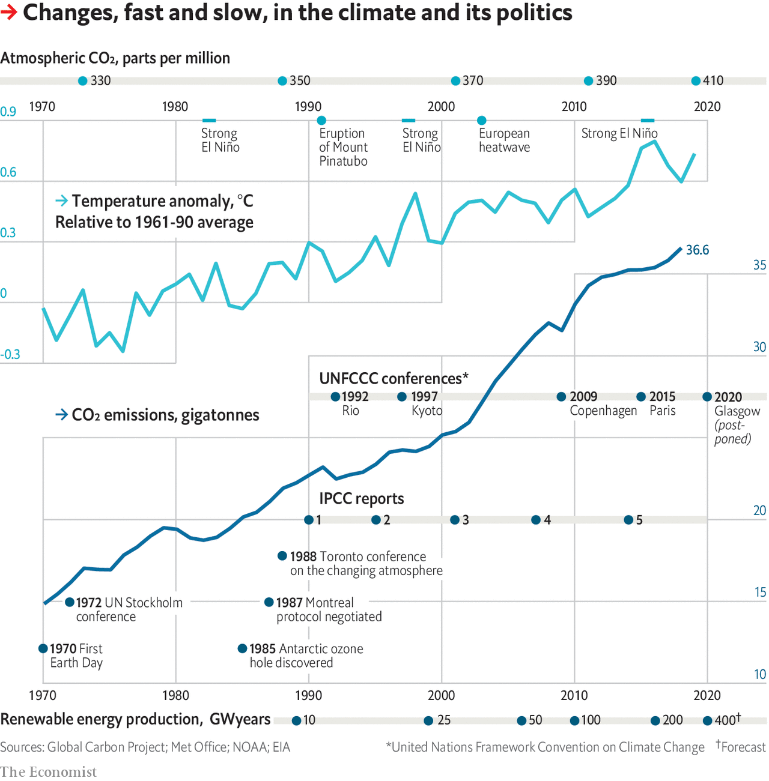

Slide 11
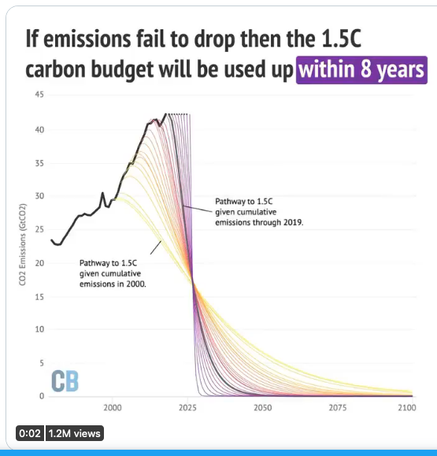
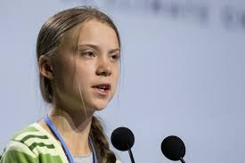
Not enough
Check this tweet (UN data, december 2019, on the adaptation required to match the limits to emissions as declared by the Paris Agreement): https://twitter.com/GretaThunberg/status/1220355420600008704

Slide 12
Just facts
It took 99.9% of modern humans’ 200,000 year history for a population of one billion in the early 19th century.
In just the following 200 years (1/1000th as much time) it ballooned to 7.7 billion by 2018.
This was an energy revolution. From 1800 to 2016, globally fossil energy use increased over 1300 fold.
By 1997 (when annual consumption was 40% less than in 2018) humanity was already burning fossil fuel
containing about 422 times the net amount of carbon fixed by photosynthesis globally each year.
Meanwhile, between 1800 and the present, real average per capita GDP and incomes rose by a factor of 13
(rising to 25-fold in the richest countries). Inevitably, material consumption and pollution rose, driving a
degradation of air, land and water. With exponential growth, half the fossil energy ever used
(and half of the fossil CO2 ever produced), has been burned or emitted in just the past 25-30 years.
During the 20th Century our species became the major geological force changing the earth.

Slide 13
Two major impacts: scarcity of water and plenty of fires

Slide 14
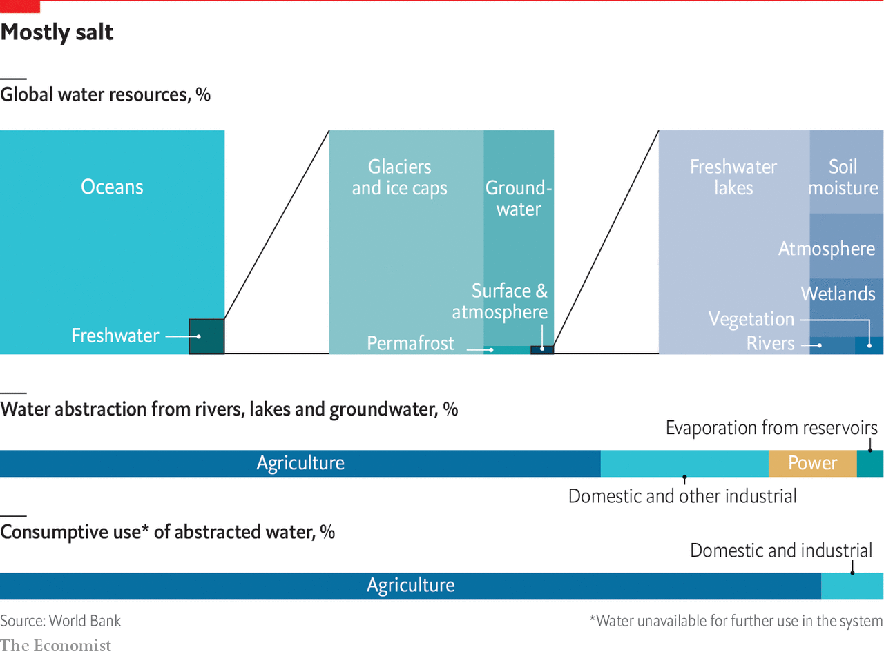
Water: the strategic resource of the 21st century

Slide 15
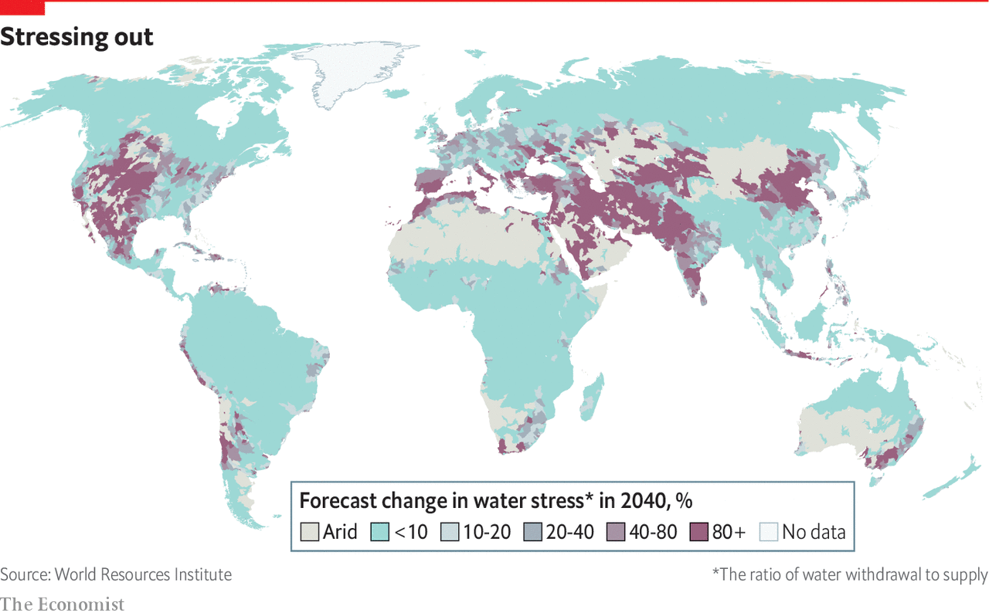
Water stress in 2040

Slide 16
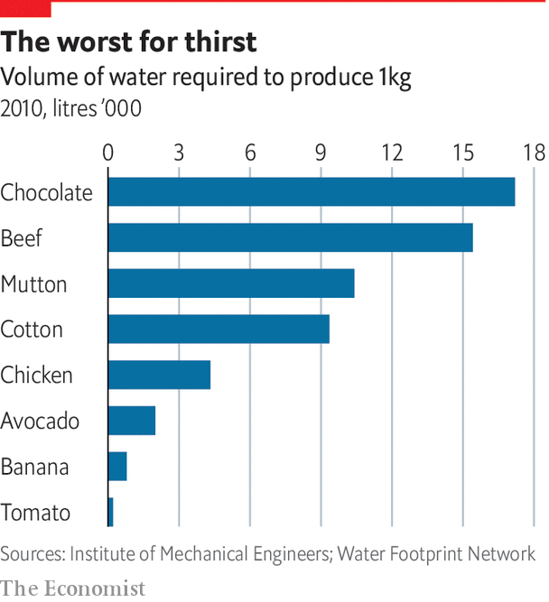
Thirst for water, today

Slide 17
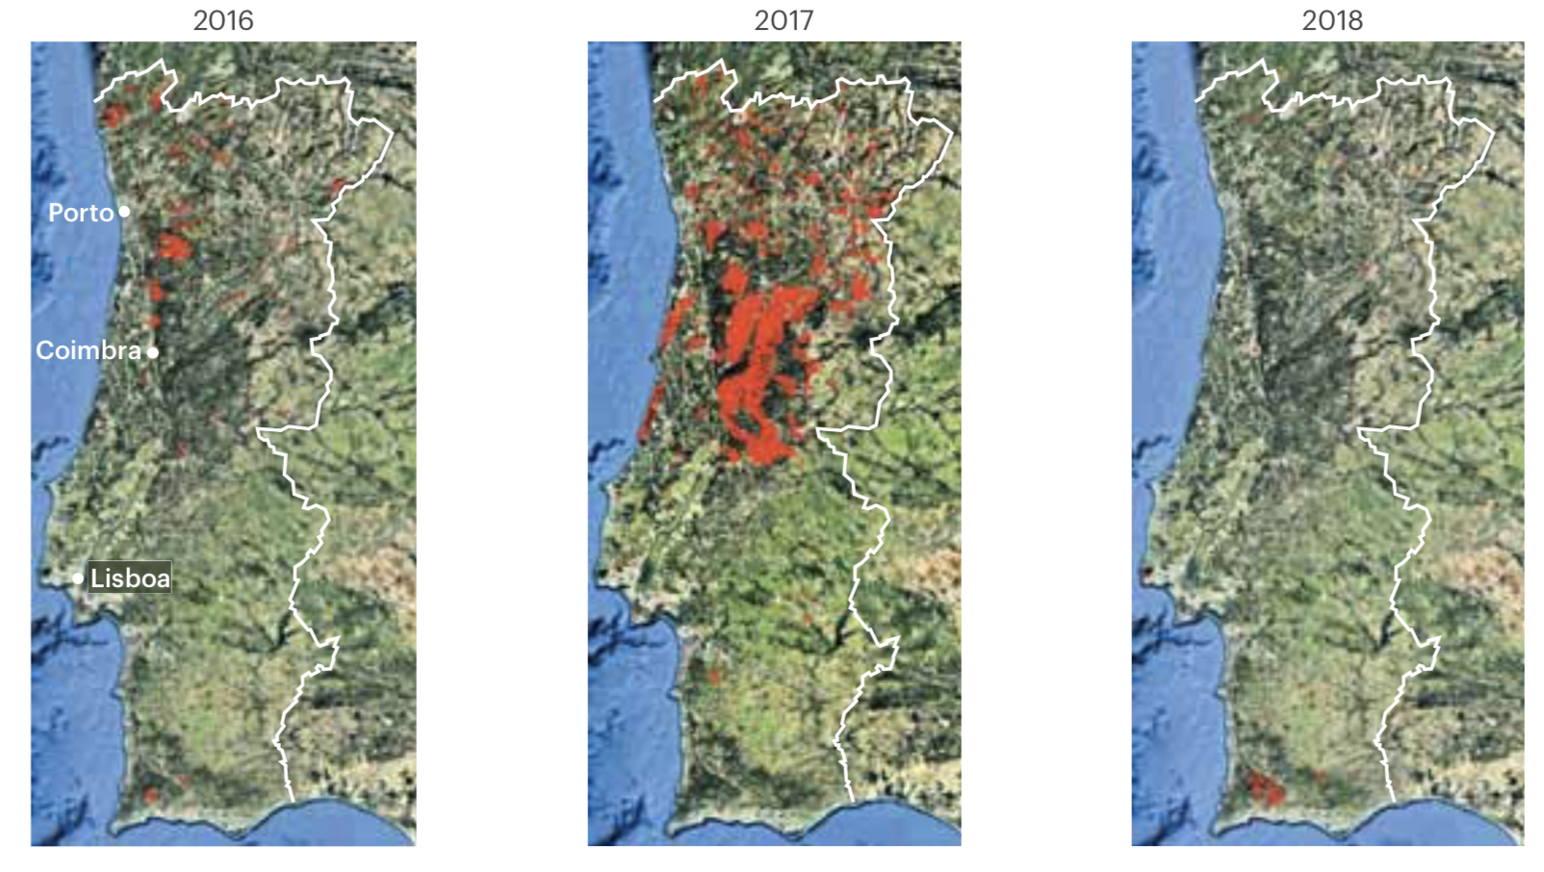
Fires in Portugal

Slide 18
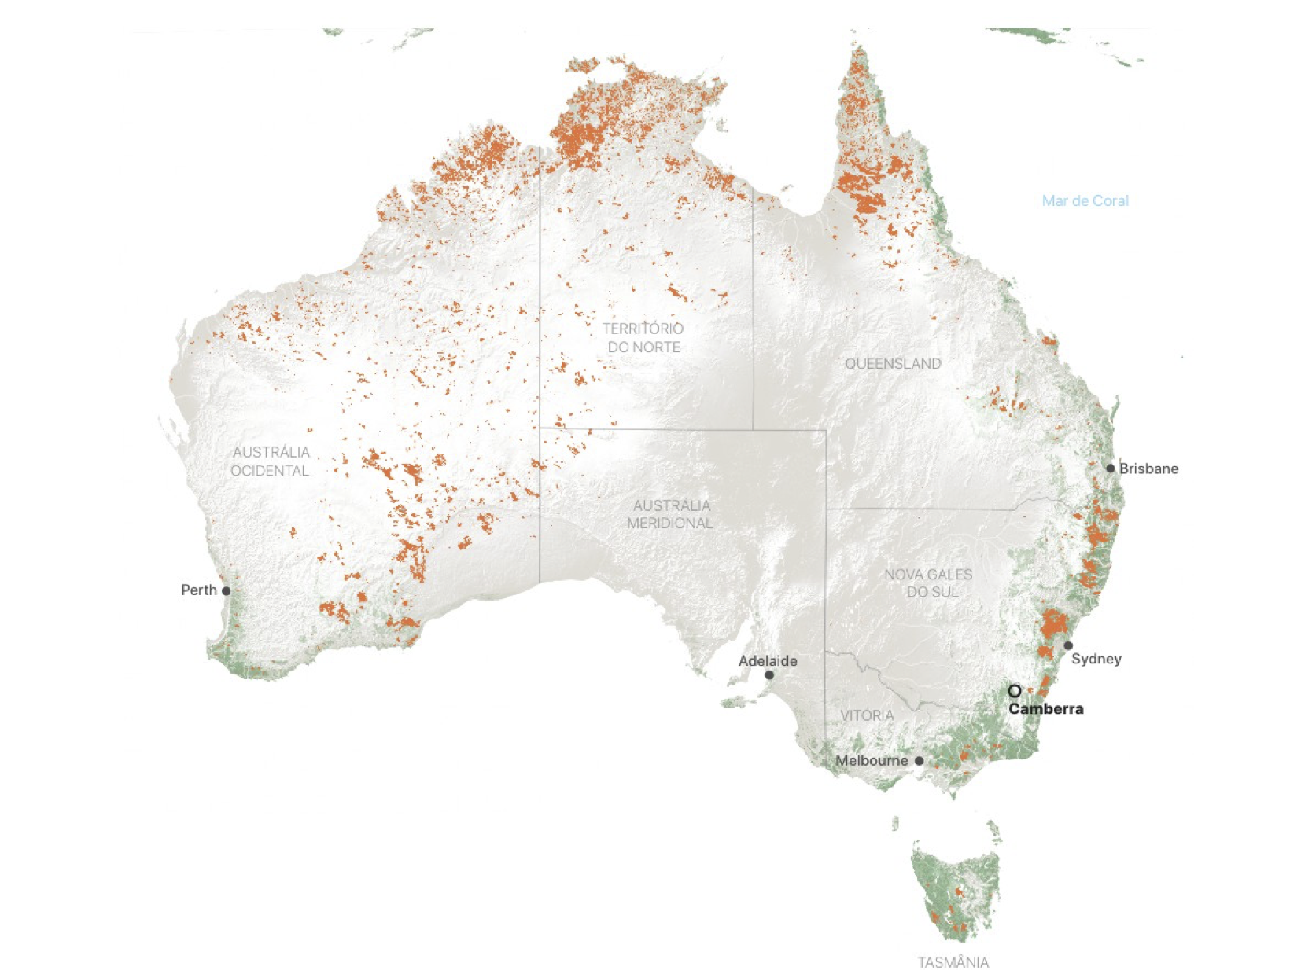
There is a problem:
Australian fires, September 2019-February 2020

Slide 19

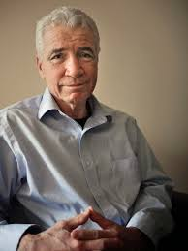
The Nordhaus-Weitzman debate
Discussion on the “calamity theorem”, by Weitzman, on the catastrophic effects of global emissions
But how do you compute the future?
If a trillion dollars damage is anticipated for 2100, at a discount rate of 4% you need 86 billion of investment today; if you consider 7%, only 4 billion are required (Weitzman argues for the first alternative, Nordhaus for the second)
Nordhaus: with a moderate carbon tax, only more 3ºC of global warming with loss of 2% of welfare (or consumption)

Slide 20
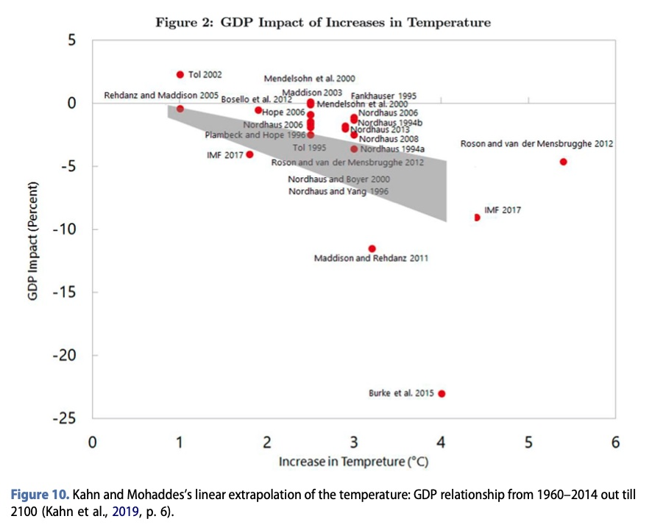
The mistakes of Nordhaus and other economists?

Slide 21
An agenda for climate change politics:
Change of transport systems, namely urban transportation and long distance (railroads)
Transformation of industrial production, with low emissions
Creation of new activities (recycling)
Transformation of agriculture, reduction of cattle and growth of forests
Changes in food habits
Changes in international trade, protection of local production
New professions, new training and education
Incentives to innovate

